Slide 1
ESENER 2024 – Key insights from first findings
European Survey of Enterprises on New and Emerging Risks

Slide 2

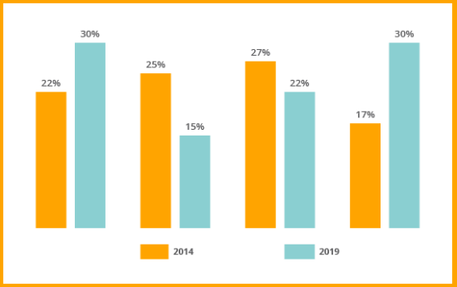
European Survey of Enterprises on New and Emerging Risks (ESENER)
www.esener.eu
How are European workplaces managing occupational safety and health (OSH)?
Waves: 2009-2014-2019-2024.
Mode: computer-assisted telephone interview (CATI) / online.
Countries: at least EU-27 + Iceland and Norway + Switzerland.
Establishments surveyed: over 40,000.
Business size: from 5 employees on.
Activity sector: all public and private, including agriculture.
Respondent: person ‘who knows best about safety and health in their establishment’
Topics: OSH management, psychosocial risks, worker representation, drivers and barriers to OSH
Comparability between ESENER 2014, 2019 and 2024!

Slide 3
Who knows best about health and safety in European workplaces? By size
% share of workplaces, EU-27 (2024)
In over 50% of the smallest workplaces, the owner, managing director, or site manager typically handles OSH. As workplace size increases, this responsibility shifts to someone in a more specialised role (OSH specialist without managerial function).
The profile of ESENER respondents by business size is largely consistent across countries and survey waves.
Owner of a firm, managing director, site manager
Manager without
specific OSH tasks
5-9
Manager with
specific OSH tasks
OSH specialist without managerial
function
10-49
Employee representative in charge of OSH
50-249
Another employee in charge of the subject
External OSH consultant
250+
No answer
0
10
20
30
40
50
60
70
80
90
100
Base: All establishments in the EU-27

Slide 4
Achieved sample sizes: ESENER 2024
Country | Interviews for ESENER 2024
Austria | 1,829
Belgium | 1,504
Bulgaria | 765
Croatia | 776
Cyprus | 753
Czech Republic | 1,526
Denmark | 1,506
Estonia | 768
Finland | 1,510
France | 2,273
Country | Interviews for ESENER 2024
Germany | 3,159
Greece | 1,501
Hungary | 1,510
Iceland | 810
Ireland | 761
Italy | 2,255
Latvia | 756
Lithuania | 762
Luxembourg | 759
Malta | 453
Country | Interviews for ESENER 2024
Netherlands | 1,505
Norway | 1,523
Poland | 2,268
Portugal | 1,545
Romania | 1,537
Slovakia | 786
Slovenia | 1,056
Spain | 2,259
Sweden | 1,536
Switzerland | 1,507
Total: | 41,458

Slide 5
Changing world of work: selection of indicators
% share of workplaces, EU-27 (2019-2024, when available)
Workplaces with remote employees jumped from 13% to 23% since 2019, with 77% of these workplaces consulting their employees on home working practices. Risk assessments covering home workplaces have risen from 31% to 48% and over half of companies carrying out risk assessments include digital technologies in their risk assessments.
Indicator | ESENER question | EU-27
 |  | 2019 | 2024
Workplaces | Employees working from home on a regular basis | 13 | 23
 | Risk assessments cover home workplaces (1) | 31 | 48
 | Employees consulted on working from home practices (2) |  | 77
 | Use of digital technologies covered in risk assessments (3) |  | 56
Language | Having employees that have difficulties understanding the language spoken at the premises | 8 | 10
Training | Routine use of digital technologies (4) |  | 44
 | Assess mobile or external workplaces on OSH risks (5) | 42 | 45
Base: asked to all establishments in the EU-27 except: (1) carrying out risk assessments and having employees working from home (2) having employees working from home (3) carrying out risk assessments (4) reporting use of digital technologies (5) having employees working from home and or anywhere else outside the premises of the establishment

Slide 6
Most frequently identified risk factors
% share of workplaces, EU-27 (2014-2019-2024)
Reported risk factors remain stable over time. In 2024, the top two are still musculoskeletal disorders. Psychosocial risks are also common, especially in service sectors.
 | 2014 | 2019 | 2024
Risk of accidents with vehicles in the course of work | 46 | 44 | 43
Time pressure | 43 | 45 | 43
Increased risk of slips, trips and falls | 34 | 34 | 37
Heat, cold or draught | 36 | 37 | 37
Chemical or biological substances | 36 | 36 | 36
Tiring or painful positions |  | 32 | 33
Loud noise | 30 | 30 | 32
Poor communication or cooperation within the organisation | 16 | 18 | 19
Long or irregular working hours | 21 | 21 | 18
Fear of job loss |  | 11 | 10
2014
2019
2024
100
80
60
40
20
0
Prolonged sitting
Repetitive hand or arm movements
Having to deal with difficult customers, patients, pupils etc.
Lifting or moving people or heavy loads
Risk of accidents with machines or hand tools
Base: all establishments in the EU-27

Slide 7
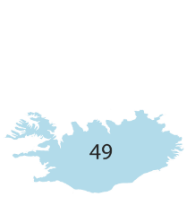


Workplaces carrying out regular risk assessments, by country
% share of workplaces (2024)
Over three-quarters of workplaces conduct regular risk assessments, a trend consistent with previous years. In 2024, notable country differences emerge compared to the EU-27 average (76%), with significant changes in some countries over the years (see chart below).
4499
49
89
87
83
2014
2019
2024
83
85
82
75
74
78
79
66
66
46
79
75
57
45
64
72
64
89
93
85
95
8855
84
65
72
24
Base: all establishments in the EU-27
51

Slide 8
Reasons for not carrying out risk assessments, by company size
% share of workplaces, EU-27 (2024)
Companies that do not assess their risks often believe they know the hazards or face no major issues, especially smaller workplaces. This suggests a lack of risk awareness, a stable trend over the years, with complexity (‘the procedure being too burdensome’) not being a major deterrent.
80
80
79
78
78
71
57
57
The hazards and risks are already known
There are no major problems
5-9 empl
10-49 empl
50-249 empl 250 or more empl
28
31
36
40
19
22
23
33
The necessary expertise is lacking
The procedure is too burdensome
Base: asked to establishments in the EU-27 that do NOT carry out risk assessments.

Slide 9
Measures to prevent musculoskeletal disorders
% share of workplaces, EU-27 (2014-2019-2024)
Despite a modest rise in workplaces that implement measures to prevent musculoskeletal disorders (MSDs) since 2019,
levels still remain below 2014 figures. This is concerning as the overall reporting of MSDs in workplaces continues to grow.
100
90
85
80
77
77
73
66
67
71
70
60
64
60
59
53
54
50
48
49
40
30
20
10
0
2014
2019
2024
Provision of equipment to help with the lifting or moving (1)
Rotation of tasks to reduce repetitive movements (2)
Encouraging regular breaks for people in uncomfortable working positions
Provision of ergonomic equipment
The possibility for people with health problems to reduce working hours
Base: asked to all establishments in the EU-27, except for:
  only asked in establishments reporting lifting or moving people or heavy loads as a risk factor
  only asked in establishments reporting repetitive hand or arm movements as a risk factor

Slide 10
Measures to prevent psychosocial risks, by company size
% share of workplaces, EU-27 (2024)
Small businesses include more employee decision-making, while larger ones propose more diverse measures to prevent psychosocial risks. Top measures are confidential counselling and conflict resolution training in the largest workplaces. Overall, all measures have increased since 2014.
100
80
72
70
68
65
60
60
56
Allowing employees to take more decisions on how to do their job
50
44
43
43
Reorganisation of work in order to reduce job demands and work pressure
40
33
30
28
Confidential counselling for employees
20
Training on conflict resolution
10
0
Intervention if
excessively long or
irregular hours are worked
5-9 empl
250 or more empl
Base: asked to all establishments in the EU-27.

Slide 11
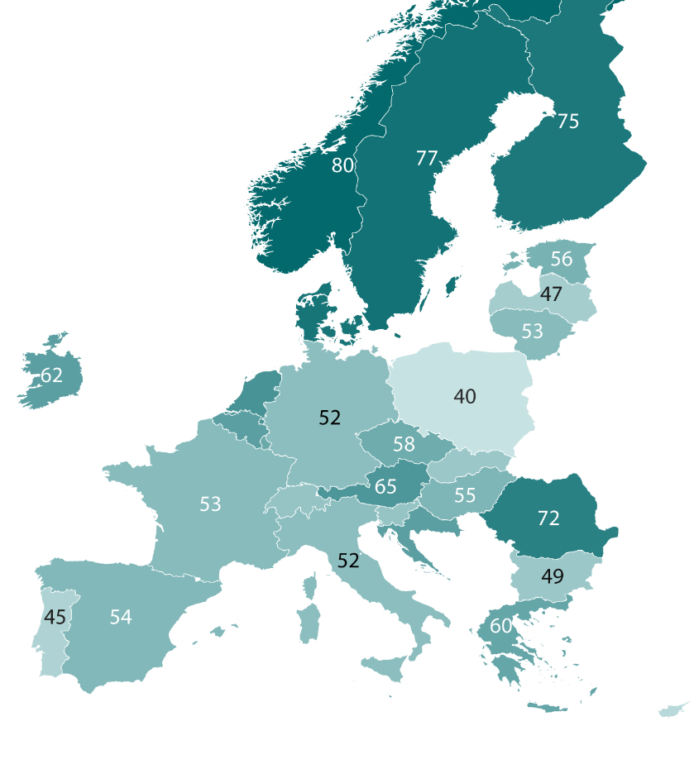

Employee involvement in measures to address psychosocial risks, by country
% share of workplaces (2024)
Psychosocial risk measures often lack worker involvement but there are clear country variations in 2024: Workers are reported to be involved in such measures in 77% of workplaces in Sweden and 76% in Denmark as opposed to 40% in Poland and 43% in Cyprus.
In general, the EU-27 has seen a slight but consistent decline since 63% in 2014 to 55% in 2024.
75
80
77
70
56
47
76
53
62
66
52
40
62
59
12
58
49
53
50
65
55
50
72
62
52
49
45
54
60
61
43
Base: asked to establishments in the EU-27 that report having at least one measure in place to prevent psychosocial risks.

Slide 12
Major reasons for addressing health and safety
% share of workplaces, EU-27 (2024)
Reasons for addressing health and safety remain stable over the last 10 years.
Legal obligations consistently rank first in most countries, but other reasons also receive high ratings.
100
80
60
40
20
0
Fulfilling legal
obligation
Meeting expectations from employees or their representatives
Avoiding fines from the labour inspectorate
Maintaining the organisation’s reputation
Maintaining
or increasing productivity
Base: all establishments in the EU-27

Slide 13
Visits from labour inspectors, by country
% share of workplaces (2014-2024)
Europe presents a very diverse landscape regarding labour inspection visits, which are reported to be decreasing in general since 2014.
2014
2024
Base: asked to all establishments

Slide 14
Requirements from clients or suppliers to meet OSH standards, by sector % share of workplaces, EU-27 (2024)
Half of small businesses engage in OSH due to client, supplier, or organisational requirements. Sector differences are clear, with requirements ranging from 34% in finance and insurance to 67% in construction.
Construction
67
 | 2024
Financial and Insurance Activities | 34
Information and Communication | 41
Real Estate Activities | 42
Other Service Activities | 42
Professional, Scientific and Technical Activities | 46
Mining and Quarrying | 47
Accommodation and Food Service Activities | 47
Education | 47
Public Administration and Defence; Compulsory Social Security | 48
Wholesale and Retail Trade; Repair of Motor Vehicles and Motorcycles | 48
Arts, Entertainment and Recreation | 49
Transportation
and Storage
62
Water Supply: Sewage; Waste Management
and Remediation Activities
59
Electricity, Gas, Steam
and Air Conditioning Supply
56
Agriculture Forest
and Fishing
55
Human Health and
Social Work Activities
52
Administrative and
Support Service Activities
52
Manufacturing
51
EU-27
50
0
20
40
60
80
100
Base: asked to all establishments in the EU-27 employing up to 50 people

Slide 15
Major difficulties in addressing health and safety
% share of workplaces, EU-27 (2014-2019-2024)
40% of workplaces find legal obligations a major challenge for OSH management, a stable figure but slightly declining. Since 2014, financial constraints have seen the biggest drop whereas lack of time or staff has increased.
100
80
2014
2019
2024
60
42
41
40
40
31
31
29
33
32
27
24
19
17
19
19
18
20
14 14 14
13
12 12
0
The complexity of legal obligations
The paperwork
A lack of time or staff
A lack of money
A lack of awareness among staff
A lack of expertise or specialist support
A lack of awareness among management
Base: asked to all establishments in the EU-27

Slide 16
Complexity of legal obligations as major difficulty addressing OSH, by country
% share of workplaces (2024)
Despite a common EU OSH Framework Directive, perceptions of OSH legislation complexity vary widely across countries. National differences in OSH management reveal diverse challenges across the EU-27. In 2024, legal obligations are perceived to be a major hurdle for Belgium, Italy, and the Netherlands, while Malta, Finland, and Lithuania report the least concerns.
Belgium
Italy
Netherlands
Poland
Germany
France
Slovakia
Austria
EU-27
Czech Republic
Spain
Luxembourg
Portugal
Bulgaria
Estonia
Cyprus
Sweden
Ireland
Greece
Romania
Croatia
Slovenia
Hungary
Denmark
Latvia
Malta
Finland
Lithuania
Evolution over time in perception of complexity - countries reporting the most/least variation
 | 2014 | 2019 | 2024
Italy | 67 | 43 | 48
Greece | 54 | 46 | 28
Slovakia | 25 | 39 | 42
Lithuania | 14 | 15 | 15
Finland | 17 | 16 | 16
Denmark | 18 | 18 | 21
0
10
20
30
40
50
60
70
80
90
100
Base: asked to all establishments

Slide 17

Digital technologies used at work
% share of workplaces, EU-27 (2024)
Besides common technologies like PCs and laptops, wearable devices are the next most frequently used at work. 35% of workplaces in the EU-27 discuss the technologies’ impact on worker health and safety, up from 24% in 2019.
Discuss impact of digital technologies on workers’ health and safety
2024
35
Automatic task, working time or shift
Wearable devices
allocation
Robots interacting with workers
9
13
4
AI-based systems performing work tasks
7
Monitoring workers’ performance or behaviour
7
Laptops, tablets, smartphones
83
Personal computers at fixed workplaces
87
24
2019
Base: asked to all establishments in the EU-27
Base: asked to establishments in the EU-27 reporting the use of at least one digital technology

Slide 18
Risk factors linked to the use of digital technologies at work
% share of workplaces, EU-27 (2024)
Prolonged sitting and repetitive movements are the risks most commonly associated with the use of digital technologies. But psychosocial risks, like increased work intensity and information overload, are also commonly reported by European workplaces.
Prolonged sitting
54
Repetitive movements
47
Increased work intensity
34
Information overload
32
Blurring boundaries between
work and private life
27
Collection of worker data
25
Lack of ability to work with digital technologies
Working alone and isolated
from colleagues
Loss of worker influence
over work pace or processes
18
12
10
Fear of job loss
9
0
20
40
60
80
100
Base: asked to establishments in the EU-27 reporting the use of at least one digital technology.

Slide 19
Forms of employee representation
% share of workplaces, EU-27 (2014-2019-2024)
Health and safety representatives are the most frequent form of employee representation again, as in previous survey waves.
100
80
56
57
58
60
40
25
24 24
22
23
2014
2019
2024
20
20
18
17
20
0
Health and safety representative
Works council
Health and safety committee
Trade union representation
Base: asked to all establishments in the EU-27

Slide 20
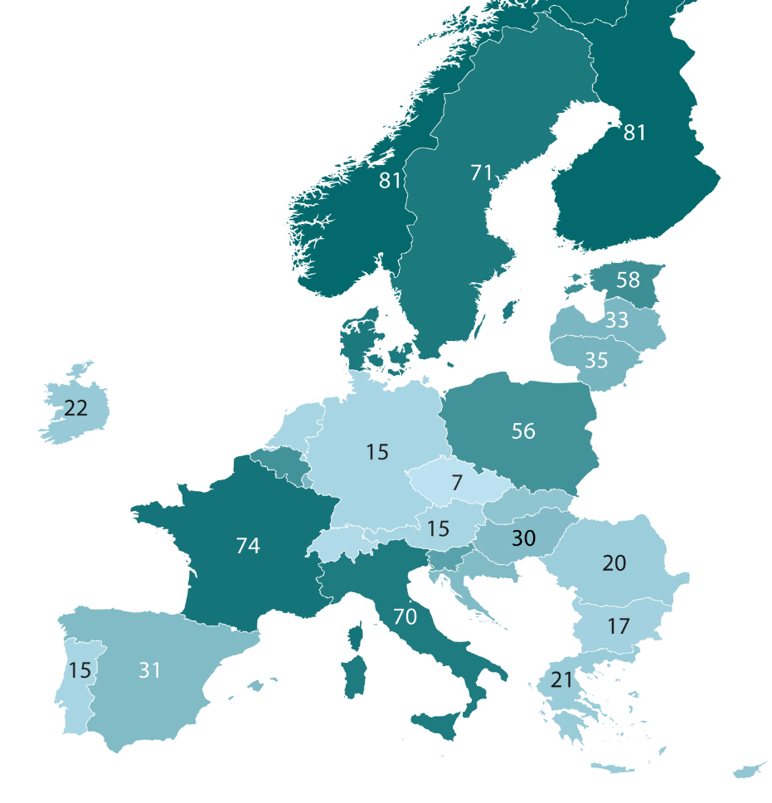
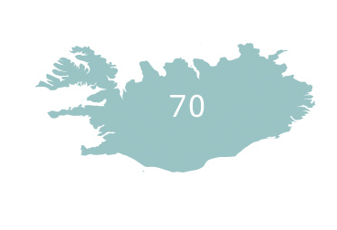
Health and safety reps elected by employees, by country
% share of workplaces (2024)
There are varied practices in selecting health and safety representatives: in some countries, it is mostly employers selecting them, while in others, employees elect their own.
The map shows the latter - the percentage share of workplaces where health and safety representatives are elected by employees: 38% in the EU-27.
81
81
71
33
58
33
71
35
22
56
15
15
12
12
33
7
15
25
74
12
46
30
20
70
64
17
15
31
21
5
24
Base: asked to all establishments reporting the presence of a health and safety representative

Slide 21
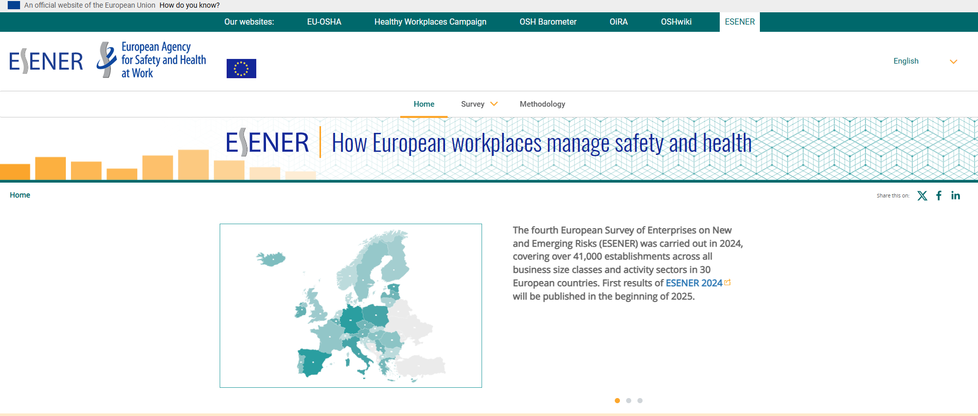
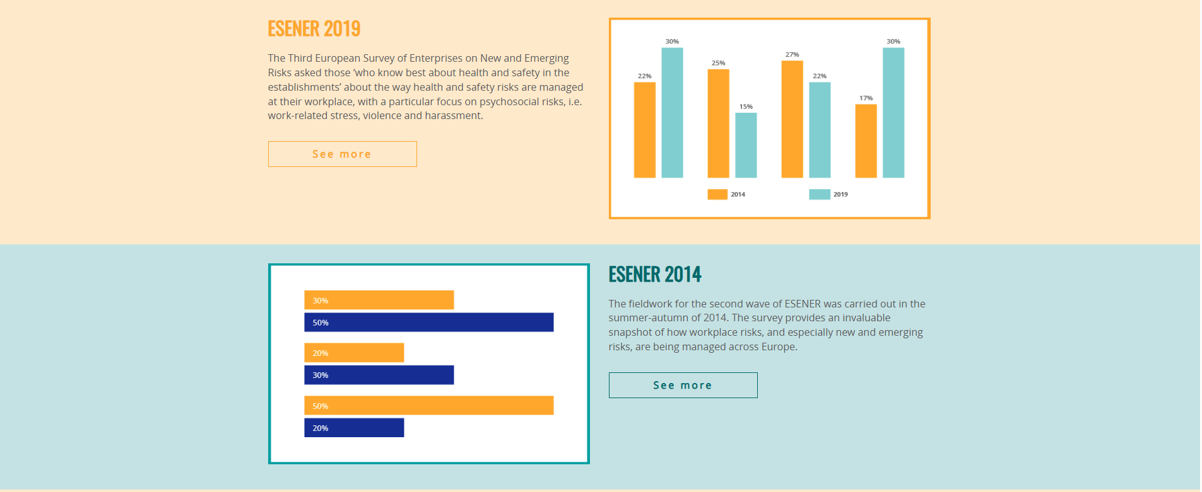
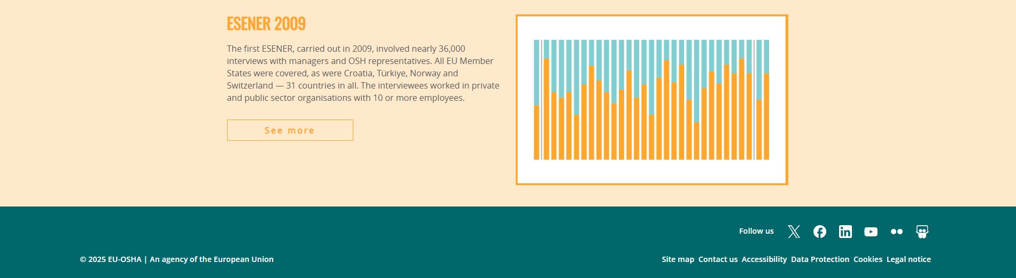
European Survey of Enterprises on New and Emerging Risks (ESENER)
Reports
Methodological information –including national questionnaires and access to ESENER datasets
Data Visualisation Tool –in all survey languages
All available at:
www.esener.eu

Slide 22
Copyright
© European Agency for Safety and Health at Work, 2025
Reproduction is authorised provided the source is acknowledged.
For reproduction or use of any photo under any other copyright than EU-OSHA, permission must be sought directly from the copyright holder.

