Slide 1
SAFE AND HEALTHY WORK IN THE DIGITAL AGE
Healthy Workplaces Campaign 2023-25
Smart digital systems: implications for occupational safety and health

Slide 2
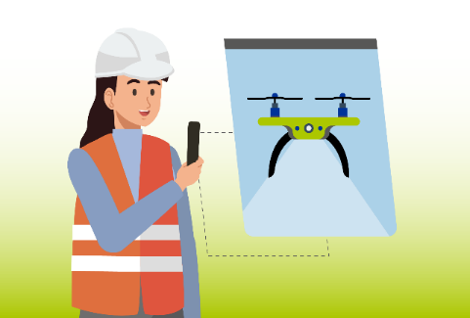


Overview
Facts and figures
Definition of smart monitoring systems
Proactive and reactive OSH monitoring
Opportunities and challenges for OSH
Case studies
Focus on data management (privacy) and worker involvement
Principles for design and use
Key takeaways

Slide 3
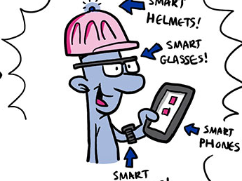
Increase uptake of wearables expected
EU-OSHA, ESENER 2019, OSH PULSE 2022
11% of workers use wearables at work and 3% work with cobots
19% used to monitor noise, chemicals, dust, gases, and other hazardous substances
7% used to monitor heart rate, blood pressure, posture, etc
Adoption is currently limited, this could change soon
© EU-OSHA, Drawnalism
Notes:
At the company level, ESENER 2019 data show that 4.8% of the surveyed establishments used wearable devices and 3.7% used collaborative robots (cobots). They also show a strong correlation between the size of an establishment and the uptake of digital technologies. Larger establishments tend to have more financial resources for long-term R & D and digitalisation, as well as the technical capacity to integrate monitoring technologies across their operations. They also have the human resources to assess needs, install and deploy the technology, and provide the necessary staff training and manuals.

Slide 4
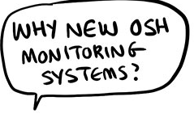
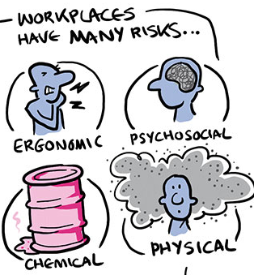
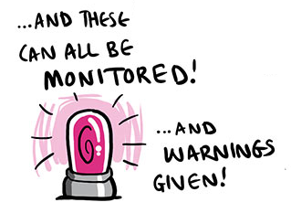


Why use smart digital tools for monitoring worker safety and health?
© EU-OSHA, Drawnalism
Notes:
They can (all) be measured, but that doesn’t mean they should be measured.

Slide 5
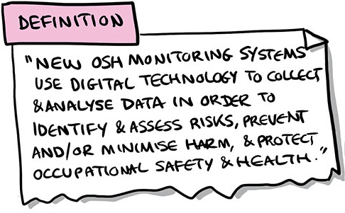
Smart digital tools, what do we mean?
Digital technology that collects and analyses data to:
Identify and assess risks
Prevent / minimise harm
Promote OSH
© EU-OSHA, Drawnalism

Slide 6
Examples of smart digital tools with real-time assessment functions
Smartphone apps
Smart glasses or drones
E-textile technologies
Smart watches
VR/AR tools
Wearable devices
Notes:
Smartphone apps can nudge workers towards healthier behaviours, allowing easy reporting and/or task assistance in the event of accidents at work.
Smart glasses or drones in the construction and the mining industries can reach and monitor dangerous areas, protecting humans from potential danger.
E-textile technologies can interact with workers via sensors that may be embedded in hardhats or safety glasses.
Smart watches enable the gathering of physiological and emotional data of people via IoT.
VR/AR tools can be used for training, as an interface providing monitoring data.
Wearable devices can identify levels of gases, toxins, noise levels, and high-risk temperatures.

Slide 7
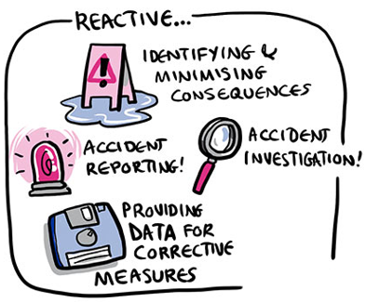
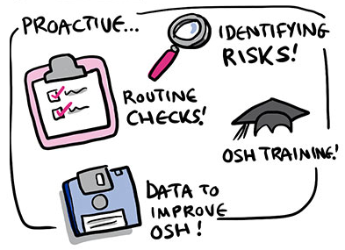
Smart digital systems: proactive versus reactive
Proactive OSH monitoring systems
Reactive OSH monitoring systems
© EU-OSHA, Drawnalism
Notes:
Identifying and preventing OSH risks
Monitoring individual or plant-related risks: heart rate, posture, fatigue, emotion
Alerting workers and providing on-the-job training
Remote risk assessments
Providing data insights that can help workplaces improve OSH
Reacting to OSH risks
Locating workers and responding to emergencies
Accident investigation and reporting
Providing data insights that can lead to corrective OSH measures

Slide 8

Opportunities for OSH
Real-time data
Predictive insights
Actionable recommendations
Proactivity
Support for the workplace:
Improved compliance
Better-informed decision-making
Increased training opportunities
Notes:
By providing real-time data, predictive insights, and even actionable recommendations, smart digital systems can help companies to adopt a proactive approach to OSH, anticipating risks, preventing accidents, and safeguarding their workforce.
Support for the workplace:
Improved compliance with OSH regulations (e.g., through real-time data on the proper use of PPE);
Better-informed decision-making, by generating accurate and fast OSH information (parameters) and the use of predictive algorithms;
More effective enforcement of measures through the identification of risks at an aggregated level;
Increased training opportunities in virtual reality environments;
Greater accessibility for workers with specific needs (e.g., ageing workers or those with health conditions) and overall improvements in workforce well-being.

Slide 9
Challenges for OSH
Use of collected data may have limitations
Smart digital systems may create new hazards or increase existing risks
Frustration
May blur OSH responsibility
Notes:
Despite the positives, there are risks and challenges that need to be considered:
The use of collected data may have limitations, such as inaccuracies or difficulties in interpretation, and may fulfil different aims than OSH prevention.
Smart digital systems may also create new hazards or increase existing risks. For instance, physical and safety risks may arise if the systems malfunction, are hacked by cyberattacks, cause explosions, or if there is an overreliance on digital OSH monitoring at the expense of other OSH procedures.
Frustration may arise over equipment malfunctions, solitary, monotonous, or repetitive tasks, the continuous monitoring of workers required by the digital system, the lack of skills or training to use them, and the frequent warnings generated by the digital technologies; these are all psychosocial risks that can be associated with increased stress and other mental health issues.
OSH responsibility may become blurred, particularly if the hierarchy of control is not respected. Collective safety measures should not be overtaken by a focus on personal control measures. Employers must also ensure that proper training, coaching, and feedback are provided to support the use and management of these systems.

Slide 10

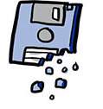
Examples of risks/challenges for OSH
Practical limitations
Technology malfunctioning
Sensor accuracy
Hardware hindering movement
Systems’ technological limitations
Net effects
Psychosocial/physical harm
Work intensification
Work alienation
© EU-OSHA, Drawnalism
Data considerations
Data privacy, security and accuracy
Data interpretation and (mis)use
© EU-OSHA, Drawnalism
Notes:
Technology malfunctioning
E.g., batteries exploding or sensors not working.
Sensor accuracy
How reliable are sensors in facilities with multiple environmental factors?
Hardware hindering movement
Wearing exoskeletons or PPEs
OSH monitoring systems’ technological limitations
E.g., infrared-cameras.
OSH monitoring systems’ net effects
E.g., impact of redistribution of weight through exoskeletons on other parts of the body.
Psychosocial/physical harm
Work intensification
Workplaces as electronic sweatshops?
Work alienation
Invasion of privacy, loss of ownership, overwhelming OSH managers with data and expectations.

Slide 11
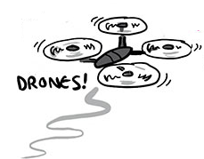


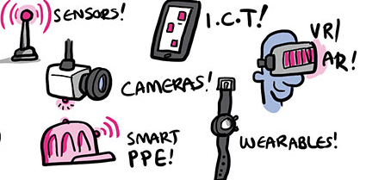

Smart digital tools for monitoring workers’ OSH: case studies
9 in-depth case studies with companies designing or using monitoring systems at the workplace
Variety of locations
Variety of technologies used
Multiple economic sectors
© EU-OSHA, Drawnalism

Slide 12
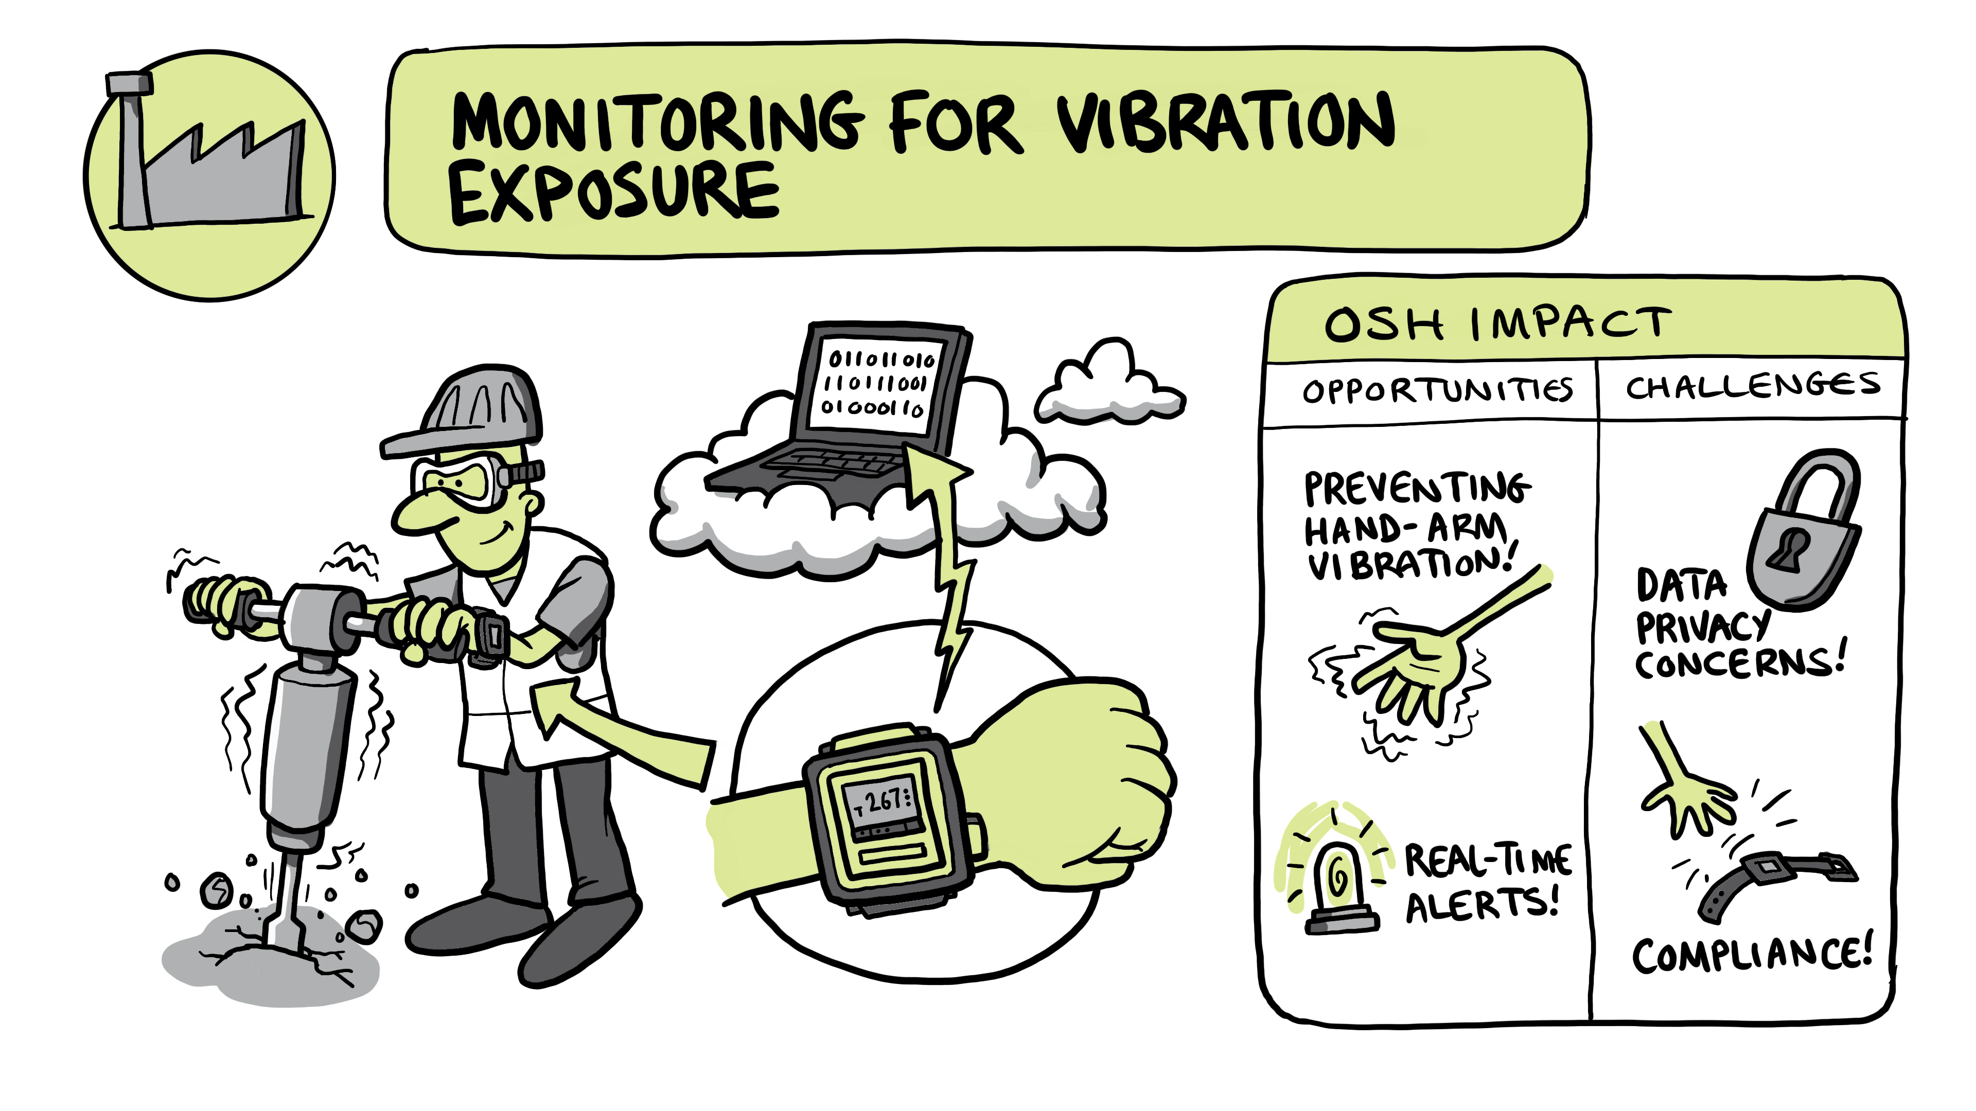
Case studies (1)
© EU-OSHA, Drawnalism

Slide 13
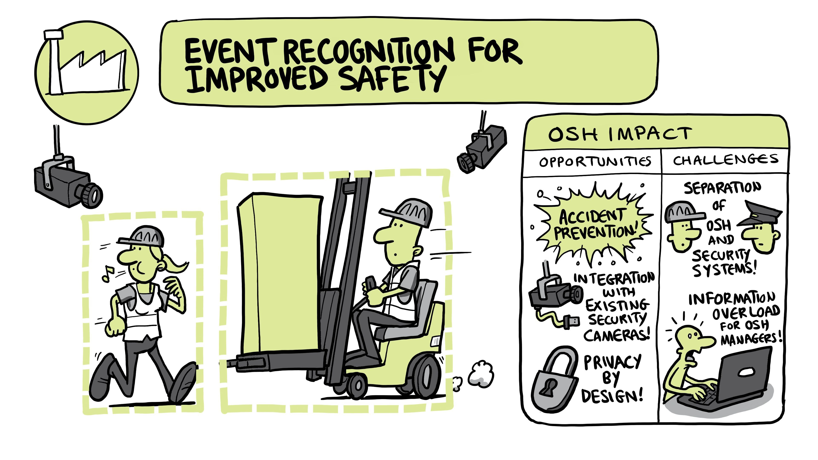
Case studies (2)
© EU-OSHA, Drawnalism

Slide 14
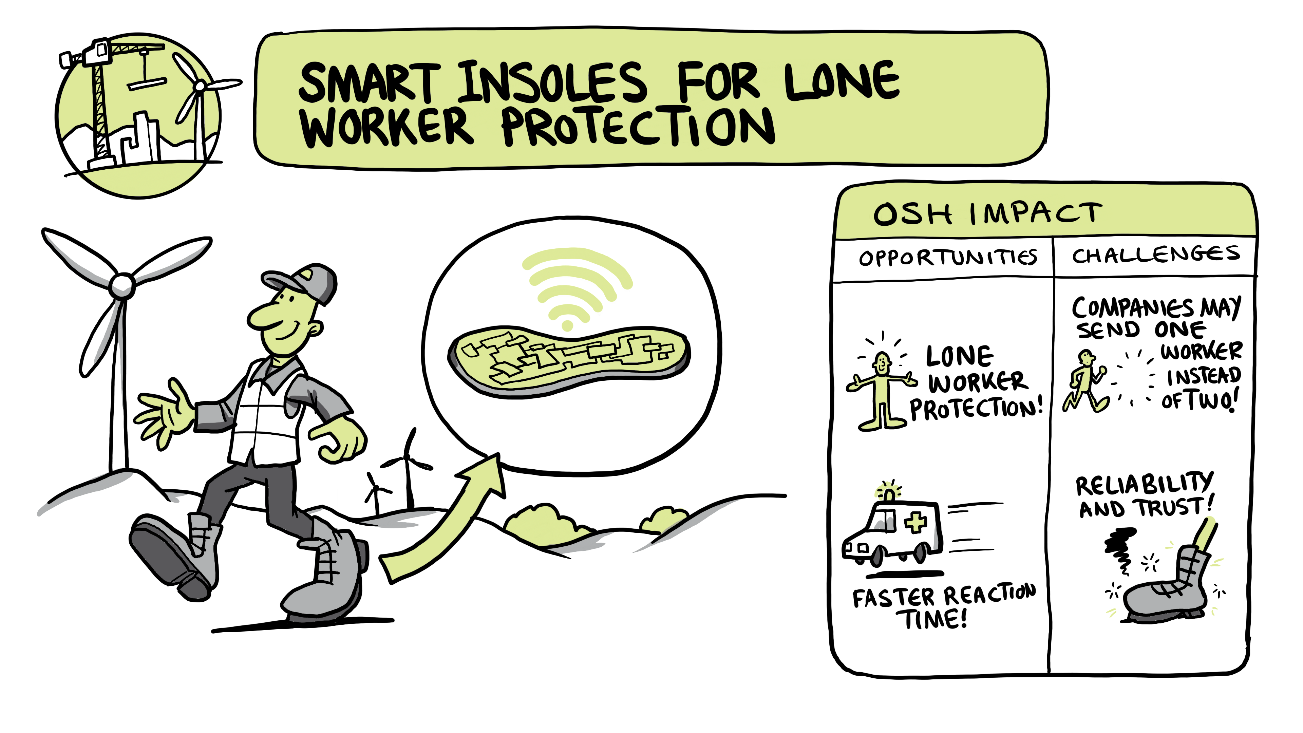
Case studies (3)
© EU-OSHA, Drawnalism

Slide 15
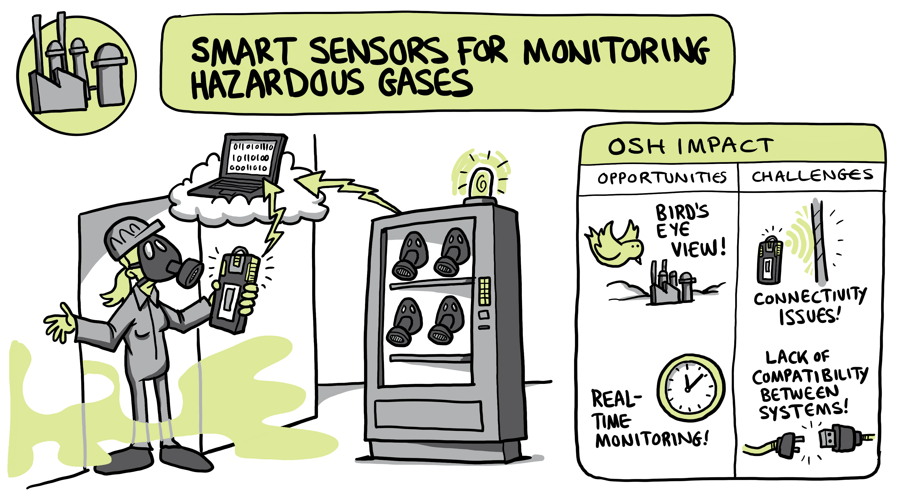
Case studies (4)
© EU-OSHA, Drawnalism

Slide 16
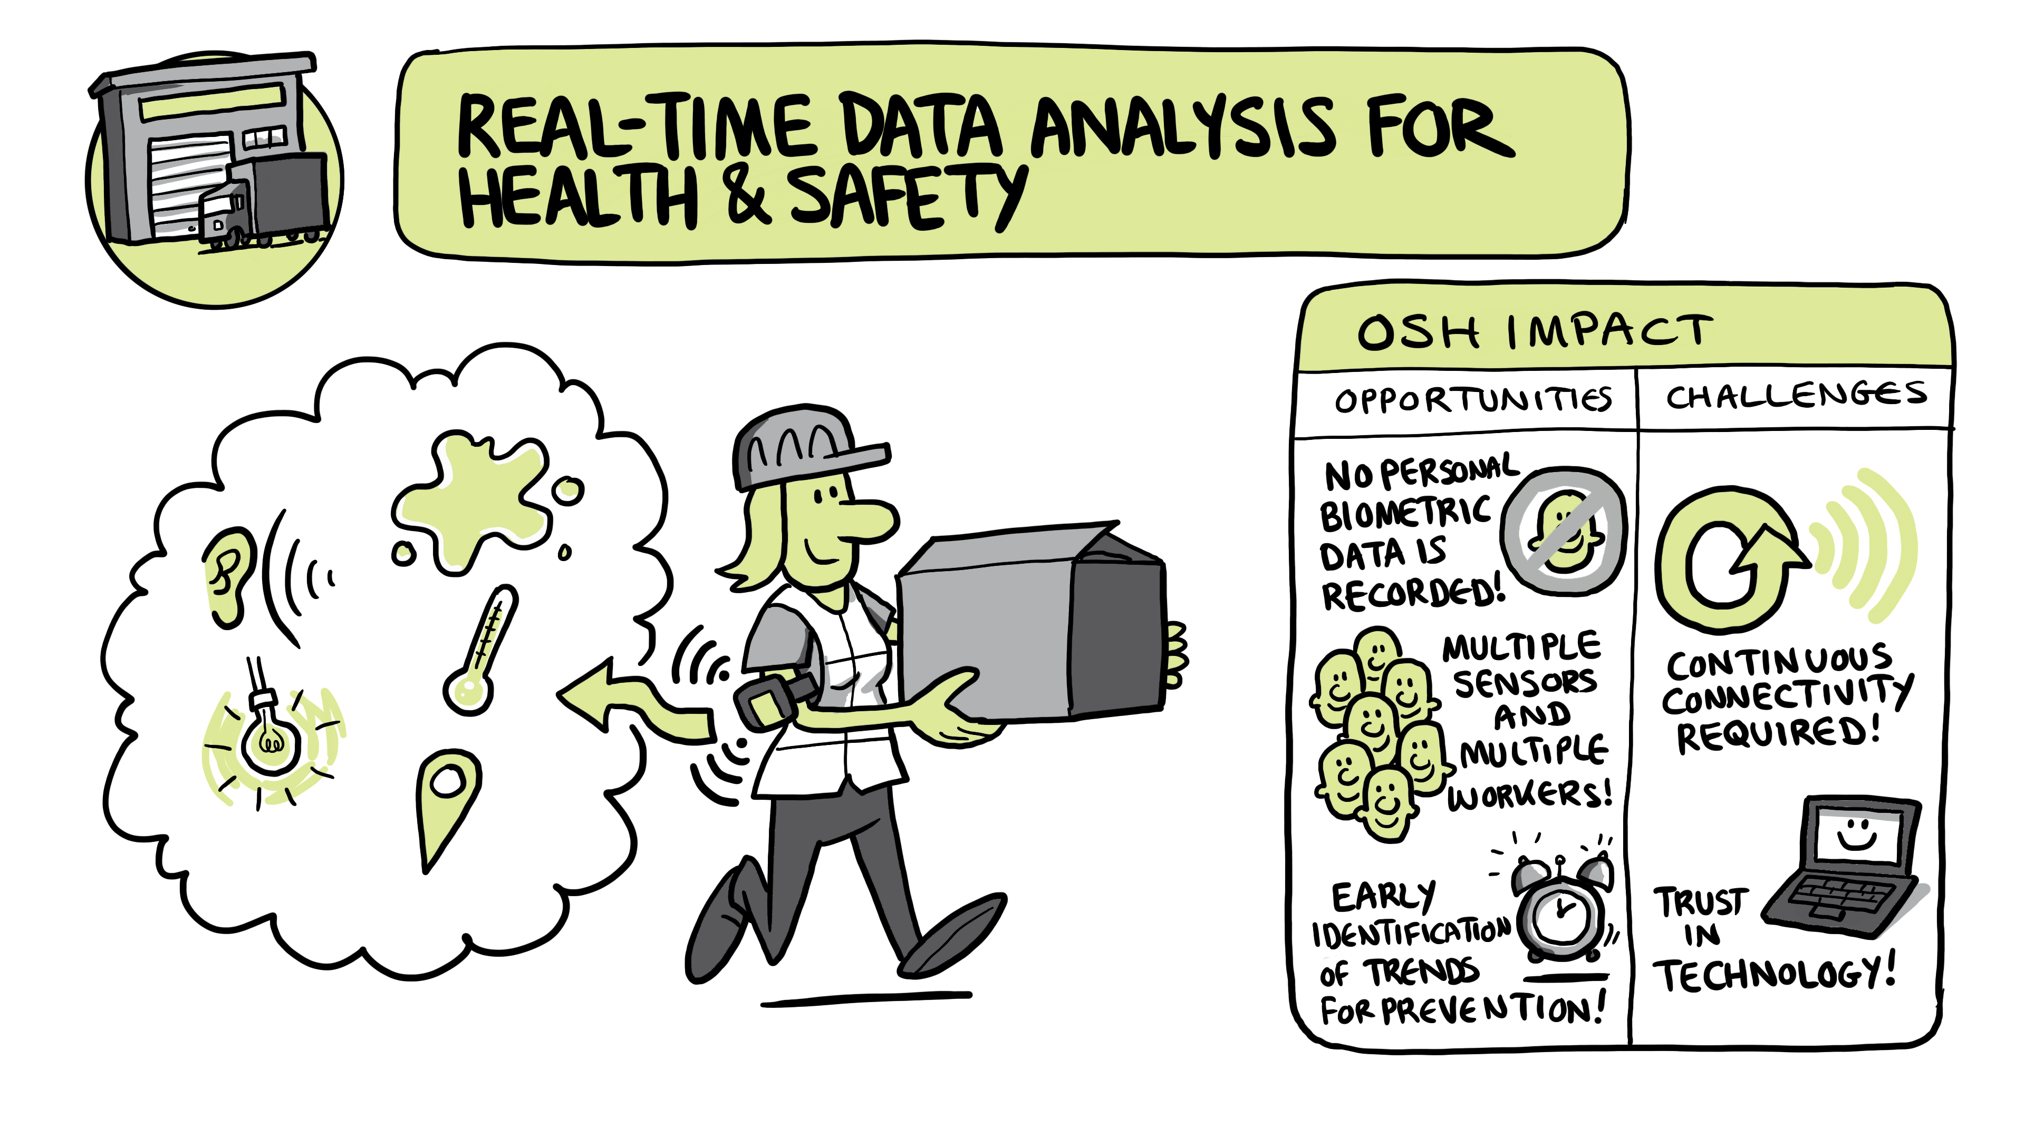
Case studies (5)
© EU-OSHA, Drawnalism

Slide 17
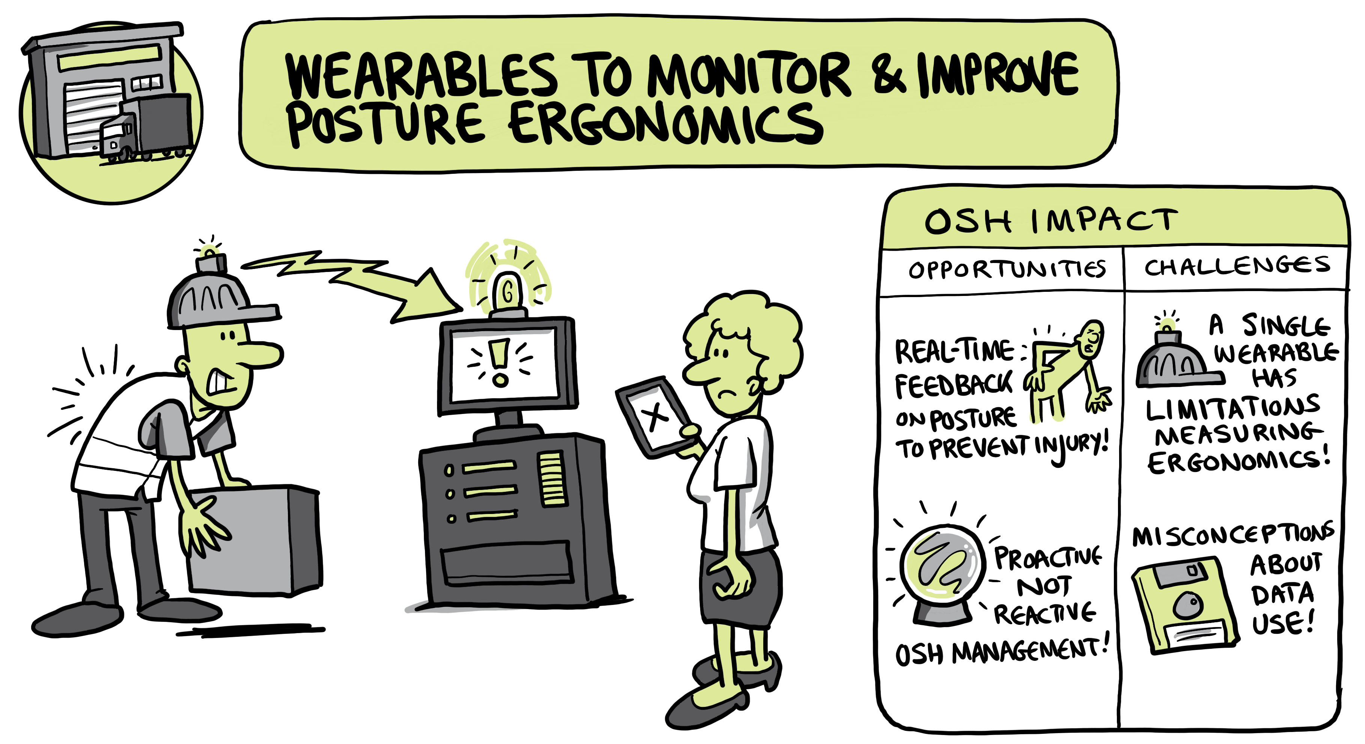
Case studies (6)
© EU-OSHA, Drawnalism

Slide 18
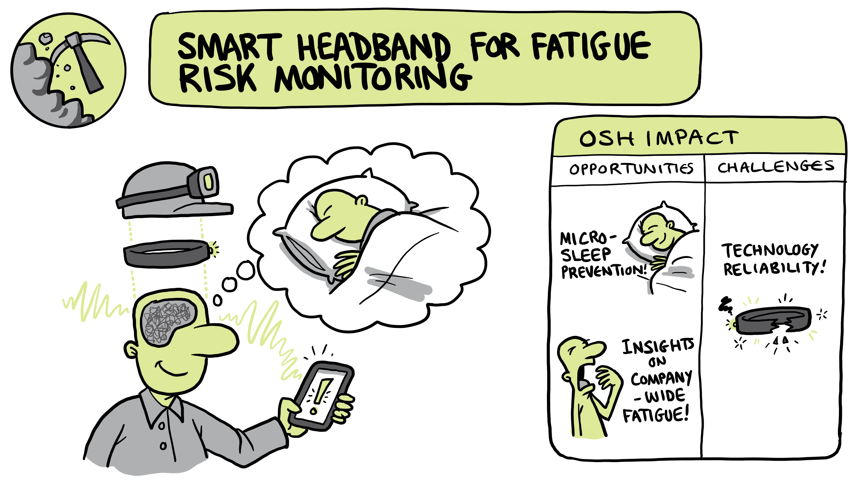
Case studies (7)
© EU-OSHA, Drawnalism

Slide 19









Case studies (8)
Data collection
Data analysis
Data display
Data insight
response
Improved information management
Real-time data monitoring
Resource-efficient allocation of OSH personnel
Tailored approach to workplace locations' specific needs
Centralised system of OSH management
Overreliance on technology
Insufficient staff skills
Privacy and security concerns
Resistance from workers
By Mohamed Hassan via Pixabay

Slide 20
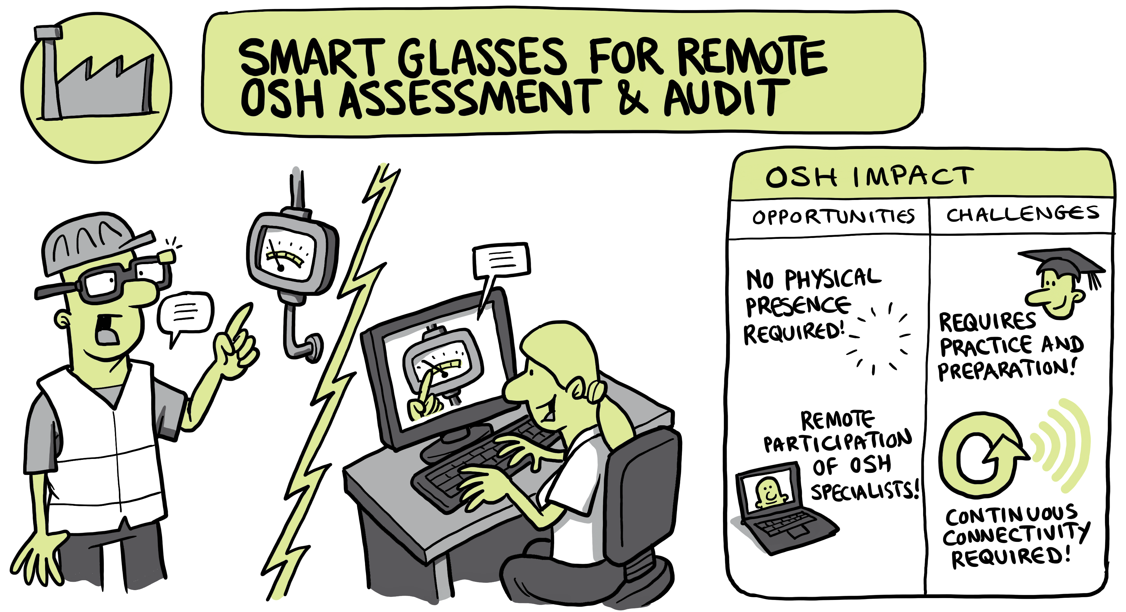
Case studies (9)
© EU-OSHA, Drawnalism

Slide 21
Worker Involvement
Prior consultation
Allow workers to test the tool or system during trial periods
Work with ambassadors
Find different engagement opportunities
On-the-job training, team briefings, walks & talks
Technology discovery workshops

Slide 22
Implementation phase: four strategies for worker
Trial period (time and/or space)
Ensuring that end-users have a solid understanding of how technology functions
APPROCHES TO INDUCTION PHASE
Step-by-step approach to training and guidance of end users
Involving employees in the decision-making process
Available support after technology implementation – technical assistance/
customer service

Slide 23





Focus on data management: privacy by design
Anonymisation
Data minimisation
Compliance
Storage and cybersecurity
On some occasions: privacy by choice;
restricting data access to designated persons
Notes:
Example:
When data minimisation leads to less performance or the tool, e.g. in rescue search you do need to know somebody’s position, then you can choose for not restricted date to designated persons instead of anomymized data.

Slide 24

Principles for safe and healthy design and development of smart digital tools for the workplace
Focus on OSH benefits
Cooperation with implementing organisations (deployers) and workers on workers’ needs
Data security and privacy
Reliability
Compatibility and integration
Customisation
User-friendliness
Scalability of the implemented solution
© EdNurg - stock.adobe.com

Slide 25
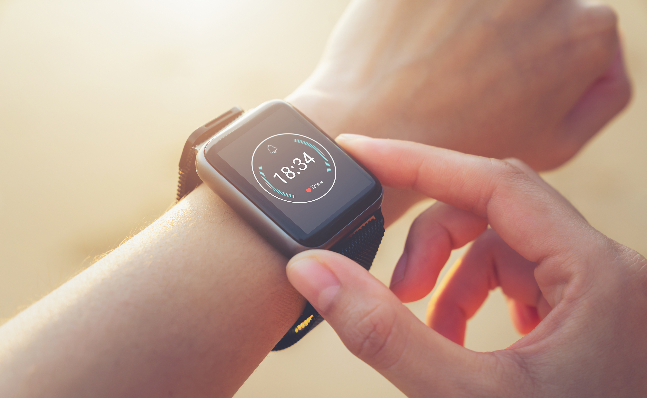
Principles for the implementation and use of smart digital systems for OSH
Involve workers
Respect data security and privacy
Define and communicate the purpose of the system
Ensure integration with existing infrastructure and OSH frameworks
Cooperate with the manufacturer (designer) during the implementation and use of the system
© Sitthiphong - stock.adobe.com
Notes:
The principles presented below are intended to show how the barriers to implementation can be addressed, and how to bring smart digital tools and OSH monitoring systems closer to the needs of workers and workplaces, therefore increasing their overall adoption, with the prospect of creating safer working environments.
Data security and privacy
Most smart digital tools and OSH monitoring systems incorporate a software system that transmits data to a cloud platform. This introduces concerns regarding data security for workers, their representatives, and employers. For example, consider the scenario where an external party gains access to a new OSH monitoring system during a rescue operation, dispatching rescue teams to a hazardous area. While this example may be extreme, it highlights the importance of implementing data security measures to mitigate the risk of potential breaches.
Integration with existing infrastructure
Some smart digital tools and OSH monitoring systems are designed to integrate with existing (OSH) management infrastructure, including software or hardware systems, which can help reduce costs and tap into new opportunities for increasing safety and health.
Integration with existing OSH frameworks
OSH is a process or cycle rather than a compartmentalised intervention, and while able to perform many functions, the systems identified in the research are not able (nor do they aim) to provide all-in-one solutions. An OSH framework should be viewed as a means of continuous learning, which involves a number of dependencies, processes, and practices. Thus, it is a framework that encompasses a wider range of elements than a single smart monitoring system.
Implementation as a cooperative process with worker involvement
Continued cooperation of the implementing company with the product manufacturer during the implementation and use of the new OSH monitoring system has been found as a common practice to tailor the system to specific needs of the workplace and workers, address potential challenges, and pinpoint improvements.

Slide 26

Smart digital tools – key takeaways
  Smart digital tools can improve workplace safety
  Transparent use of technology is essential
  Distinguishing between performance measurement and
  OSH monitoring helps maintain and build workers’ trust
  Worker engagement and involvement in the entire process
  of smart digital tool onboarding is important
  Smart digital systems must complement other OSH measures
  Legislation, labour inspections, and research must evolve
  to keep pace with smart digital systems
  Technologies like wearables promote inclusion and diversity
© Tomasz -stock.adobe.com
Notes:
Smart digital systems improve workplace safety by providing insights into working conditions in a proactive way that has not been possible until very recently. They can send alerts to reduce rescue time and facilitate reporting, and they also empower workers through increased awareness, which fosters a feeling of safety.
Transparent use of technology is essential to address concerns about privacy, data handling, and overreliance.
Distinguishing between performance measurement and OSH monitoring is a must to maintain and build workers’ trust.
Engaging workers and their representatives in the design, use, and information ecology of smart digital systems promotes workers’ health and well-being by increasing their control over decisions and facilitating their buy-in. Tailoring systems to specific workplace needs maximises effectiveness and positive impacts. Involving workers in testing, selecting, and optimising new OSH monitoring systems ensures their effectiveness.
Smart digital systems should complement other OSH measures, such as workplace adaptations, corrective actions, worker training, and fostering trust, rather than being relied upon as the sole solution or replacing them.
Legislation and labour inspections must evolve to keep pace with smart digital systems to ensure their integration in an effective OSH management system, based on employer responsibility and in the context of the hierarchy of controls.
Technologies like wearables can promote inclusion and diversity by addressing the needs of specific worker groups.

Slide 27



Resources
Consult all publications on the topic:
https://healthy-workplaces.osha.europa.eu/en/about-topic/priority-area/smart-digital-systems

Slide 28
Copyright
© European Agency for Safety and Health at Work, 2024
Reproduction is authorised provided the source is acknowledged.
Neither the European Agency for Safety and Health at Work nor any person acting on behalf of the Agency is responsible for the use that might be made of the following information.
For reproduction or use of any photo under any other copyright than EU-OSHA, permission must be sought directly from the copyright holder.
Slide 6 from top to bottom:
© Tierney - stock.adobe.com, © Tostphoto - stock.adobe.com, © Tomasz -stock.adobe.com,
© Sitthiphong - stock.adobe.com, © SFIO CRACHO - stock.adobe.com, © EdNurg - stock.adobe.com

