Slide 1
SAFE AND HEALTHY WORK IN THE DIGITAL AGE
Healthy Workplaces Campaign 2023-25
Advanced robotics and AI-based systems for the automation of tasks

Slide 2

Overview
Defining AI-based systems
Taxonomy
Current and potential uses
Impact on jobs and tasks
OSH effects
Case studies
Impact for different levels and actors
Key takeaways

Slide 3


Definition
Artificial intelligence (AI): systems with intelligent behaviour that analyses their environment and take actions – with some degree of autonomy – to achieve specific goals.
Software-based only
Voice assistants, search engines, etc.
Embodied in mechanical parts/components
Advanced robots, autonomous cars, drones

Slide 4
Task approach to automation
Tasks are a better unit of analysis when investigating the impact of automation potential. The task approach allows a more nuanced and detailed understanding of which specific aspects of human work can be more easily automated.
giving therapy
analysing sales
data
physical manipulation
cognitive
(no physical manipulation)
assembling loose parts
lifting a patient
object-related
person-related
information-related
Notes:
Advanced robotics and AI-based systems are in most cases used to automate specific tasks and not to replace humans by automating jobs.
Source: EU-OSHA (2022) Advanced robotics, artificial intelligence and the automation of tasks: definitions, uses, policies and strategies and Occupational Safety and Health, available at: https://osha.europa.eu/en/publications/advanced-robotics-artificial-intelligence-and-automation-tasks-definitions-uses-policies-and-strategies-and-occupational-safety-and-health

Slide 5
Taxonomy
Backend
(software)
complex,
not AI-based
AI-based
Frontend
(device)
physical manipulation / action:
advanced robotics
no physical manipulation / action:
smart ICT
Type of task
information-related
person-related
object-related
cognitive
physical
Task characteristics
routine
non-routine
(semi-) Automation
of tasks
assistance
substitution
OSH dimension
physical and /or psychosocial
organisational
Notes:
Source: EU-OSHA (2022) Advanced robotics, artificial intelligence and the automation of tasks: definitions, uses, policies and strategies and Occupational Safety and Health, available at: https://osha.europa.eu/en/publications/advanced-robotics-artificial-intelligence-and-automation-tasks-definitions-uses-policies-and-strategies-and-occupational-safety-and-health

Slide 6
  Advanced robotics in Europe
Sectors with Human-Robot Interaction
Human-Robot Interaction is mostly seen in the manufacturing sector
Financial and Insurance Activities
Transportation and Storage
Agriculture, Forestry and Fishing
Education
Human Health and Social Work
Accommodation and Food Service
Professional, Scientific and Technical
Construction
Wholesale and Retail Trade, Repair of Motor Vehicles
and Motorcycles
Manufacturing
0%
5%
10%
15%
20%
25%
30%
NACE (v. 2) code of enterprises with HRI according to ESENER 2019

Slide 7
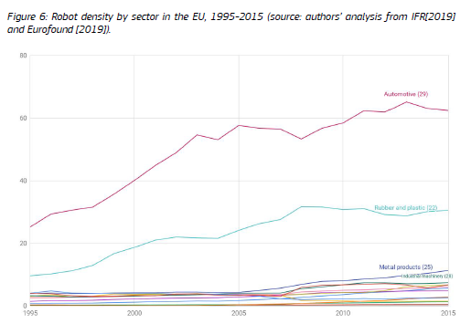
  Advanced robotics in Europe
Sectors with Human-Robot Interaction
There is a dominance of robots in the automotive sector
Robot density by sector in the EU, 1995-2015 (source: authors’ analysis from IFR [2019] and Eurofound [2019]
Automotive (29)
Rubber and plastic (22)
Rubber and plastic (22)
Metal products (25)
Industrial machinery (28)

Slide 8
Current and potential automation of physical tasks
Examples:
Human health and social work activities include robots that deliver medication
In manufacturing, there are lifting assistance and cleaning robots
Automated guided vehicles are common in transportation and storage
Inspection robots are useful in the construction sector
Human Health and Social Work Activities
Manufacturing
Other
Transportation and Storage
Construction
Mining and Quarrying
Public Administration and Defence
Notes:
Source: EU-OSHA (2022) Advanced robotics, artificial intelligence and the automation of tasks: definitions, uses, policies and strategies and Occupational Safety and Health, available at: https://osha.europa.eu/en/publications/advanced-robotics-artificial-intelligence-and-automation-tasks-definitions-uses-policies-and-strategies-and-occupational-safety-and-health

Slide 9
Current and potential automation of cognitive tasks
Examples:
Teaching assistance, AI-based vocabulary training and intelligent tutoring systems in education
Systems that can support diagnostic decisions in the scientific sector
Social robots in the administrative and support services
Human Health and Social Work Activities
Education
Professional, Scientific and Technical Activities
Other
Administrative and Support Service Activities
Information and Communication
Other
Service Activities
Construction
Manufacturing
Notes:
Source: EU-OSHA (2022) Advanced robotics, artificial intelligence and the automation of tasks: definitions, uses, policies and strategies and Occupational Safety and Health, available at: https://osha.europa.eu/en/publications/advanced-robotics-artificial-intelligence-and-automation-tasks-definitions-uses-policies-and-strategies-and-occupational-safety-and-health

Slide 10

Impact of automation on jobs
Most impacted jobs are skill-biased; they replace a more specialised but less complex skill.
Robotic systems are mainly used to substitute routine-manual tasks.
These middle-skill jobs are more easily automated because they follow repetitive, finite procedures.
Notes:
Advanced robotics & AI are likely to eliminate specific tasks, as opposed to entire jobs.
Examples of middle-skill jobs characterised by a cognitive and physical routine: traditional manufacturing, transportation services, office staff.

Slide 11



Impact of automation on physical tasks
Physical assistance in lifting objects or people
Areas like healthcare, manufacturing and construction
Reduces physical strain on workers
Transportation
Opportunities in warehouses, hospitals and offices
Cleaning of professional and living spaces
Cleaning robots are the most common privately owned
Notes:
When it comes to the impact the technology will have on physical and cognitive tasks and therefore the jobs that contain these tasks, we see differences between the areas of application.
However, robotic systems have an impact that is less job-specific and more task-related.
Automation in the cleaning area impacts jobs in which surface cleaning is a secondary task, as well as those where it is a primary task.

Slide 12


Impact of automation on cognitive tasks
Medical diagnosis and treatment
AI analyses data and provides output
Medical professionals make the final decision
As technology advances, assessment gets less supervised
Language and text processing
Textual content creation, speech production or translation
Notes:
The healthcare industry is frequently described as being on the brink of a major transformation due to these technologies. Data-based processes in the medical field are being automated, while higher cognitive tasks, like the diagnosis and treatment plan, are still carried out by skilled medical professionals. However, as the technology advances, its assessment becomes less supervised. Some medical devices, such as blood pressure monitors, can already determine the patient’s count accurately enough, so human reassessment is only necessary in exceptional situations.
Another sector facing considerable disruption is education, where AI can automate a variety of tasks, such as basic language training and preparation of lesson plans, assisting teachers so they can spend more time on individual student support.

Slide 13

OSH effects
Physical
effects
Psychosocial
effects
Organisational effects
Physical benefits
Physical risks
Long-term physical health
Function allocation
Task design
Interaction design
Operation and supervision
Introduction process and change management
Cybersecurity
Need for training
Notes:
Advanced robotics and AI-based systems create challenges and opportunities for OSH.
These effects can be classified as physical, psychosocial and organisational.

Slide 14
OSH factors and effects of AI-based systems
FEAR
STRESS
POOR MENTAL HEALTH
ACCIDENT PREVENTION
JOB LOSS
SAFETY
QUALITY OF COOPERATION
Opportunities include reduced workload, accident prevention, upskilling and reskilling.
AUTONOMY
Physical
STRESS
COMMUNICATION PROBLEMS
CONFLICTS
Psychosocial
LOSS OF AUTONOMY
LOSS OF MEANINGFULNESS
DEPERSONALISATION
SOCIAL STRUCTURE
Risks are related to all categories and include fear of job loss, self-censorship, automation bias and deskilling.
SURVEILLANCE
Organisational
LOSS OF PRIVACY
SELF-CENSORSHIP
JOB TRANSFORMATION
TRUST
- UPSKILLING
- RESKILLING
REDUCED WORKLOAD
PERFORMANCE
- DESKILLING
OVERRELIANCE
AUTOMATION BIAS
MISUSE
Opportunities
Risks
Notes:
Data based on literature.
OSH effects of AI-based systems are divided in opportunities and risks.
The opportunities relate more to the areas of safety, social structure, job transformation and trust. For instance, AI-based systems can help prevent accidents in logistics and transportation, reduce both physical and cognitive workload of employees, and enable workers to learn new skills.
The risks appear in all categories – physical, psychosocial and organisational. They encompass loss of privacy due to the surveillance of the AI systems, fear of job loss that can also lead to stress and poor mental health, loss of autonomy, deskilling, automation bias, overreliance and misuse of the system.

Slide 15
OSH factors and effects of advanced robotics
SOCIAL SUPPORT
POSITIVE ATTITUDE
MSD PREVENTION
SAFETY
HAZARD REDUCTION
DISTRUST
AUTOMATION BIAS
COMPLACENCY
Physical workload reduction and physical health improvement are the most experienced benefits. Opportunities also involve positive workflow, motivation and upskilling.
FUNCTION ALLOCATION
PHYSICAL ALTERATION OF THE WORKPLACE
MOTIVATION
SATISFACTION
Physical
PARTICIPATION
Psychosocial
EMOTIONAL EXHAUSTION
NERVOUSNESS
IRRITABILITY
REJECTION OF THE SYSTEM
TASK DESIGN
INTRODUCTION PROCESS
Risks include rejection, distrust and underutilisation of the technology, stress, deskilling and emotional exhaustion.
ACCEPTANCE
POSITIVE WORKFLOW
INTERACTION DESIGN
Organisational
ENHANCED COMMITMENT
STRESS
PERCEIVED MONITORING
UNCERTAINTY
CHANGE MANAGEMENT
UNCERTAINTY
OPERATION AND SUPERVISION
SOCIAL SUPPORT
POSITIVE ATTITUDE
TRAINING
FEAR OF JOB LOSS
UNDERUTILISATION OF THE TECHNOLOGY
UPSKILLING
Opportunities
DESKILLING
MISUSE
Risks
Notes:
Data based on literature.
The automation of physical tasks supports workers in avoiding long-term strain injuries, removing them from hazardous working environments, reducing their workload, eliminating exposure to dangerous substances and avoiding accidents.
Other opportunities of advanced robotics include positive workflow, motivation and satisfaction at work, enhanced commitment and upskilling.
On the other hand, the risks involve rejection, distrust and misuse of the technology, uncertainty about organisational changes, fear of job loss, emotional exhaustion and irritability towards the task design.

Slide 16
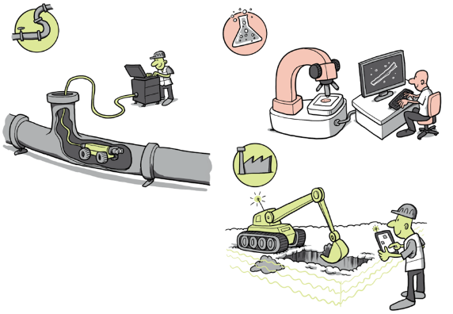
Bridging the gap between literature and practice
EU-OSHA developed 16 case studies to investigate the practical implementation of automation of physical and cognitive tasks, focusing on the impact on OSH.
Interviews with workers, OSH officers, technical engineers, workers council, management.

Slide 17
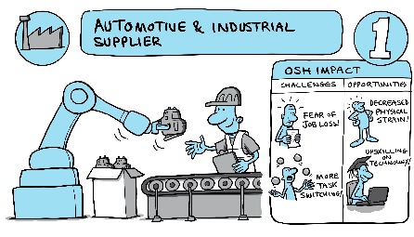
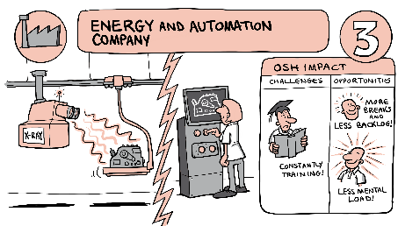
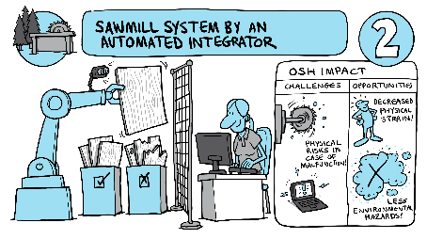
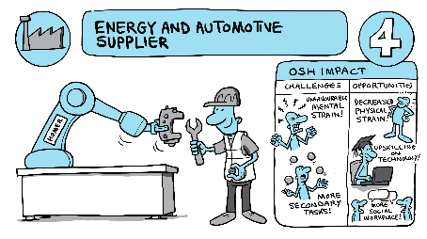
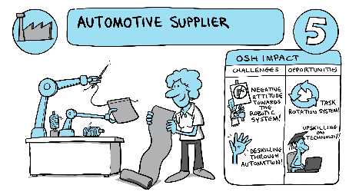
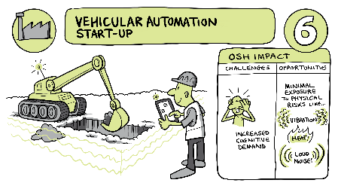
16 case studies on automation
AUTOMOTIVE & INDUSTRIAL SUPPLIER
SAWMILL SYSTEM BY AN AUTOMATED INTEGRATOR
ENERGY AND AUTOMATION
COMPANY
OSH IMPACT
OSH IMPACT
OSH IMPACT
CHALLENGES
OPPORTUNITIES
CHALLENGES
OPPORTUNITIES
CHALLENGES
OPPORTUNITIES
FEAR OF
JOB LOSS!
DECREASED
PHYSICAL
STRAIN!
DECREASED
PHYSICAL
STRAIN!
MORE
BREAKS
AND
LESS BACKLOG!
UPSKILLING
ON
TECHNOLOGY!
PHYSICAL
RISKS IN
CASE OF
MALFUNCTION!
MORE
TASK
SWITCHING!
CONSTANTLY
TRAINING!
LESS
ENVIRONMENTAL
HAZARDS!
LESS MENTAL
LOAD!
ENERGY AND AUTOMOTIVE SUPPLIER
AUTOMOTIVE SUPPLIER
VEHICULAR AUTOMATION
START-UP
OSH IMPACT
OSH IMPACT
OSH IMPACT
OSH IMPACT
OSH IMPACT
CHALLENGES
OPPORTUNITIES
OSH IMPACT
CHALLENGES
OPPORTUNITIES
CHALLENGES
OPPORTUNITIES
UNFAVOURABLE
MENTAL
STRAIN!
DECREASED
PHYSICAL
STRAIN!
NEGATIVE
ATTIUDE
TOWARDS
THE
ROBOTIC
SYSTEM!
MINIMAL
EXPOSURE
TO PHYSICAL
RISKS LIKE…
TASK
ROTATION SYSTEM!
UPSKILLING
ON
TECHNOLOGY!
UPSKILLING
ON
TECHNOLOGY!
VIBRATION
DESKILLING
THROUGH
AUTOMATION!
INCREASED
COGNITIVE
DEMAND
HEAT
MORE
SECONDARY
TASKS!
LOUD NOISE
MORE
SOCIAL
WORKPLACE!
…
Notes:
Examples of the case studies

Slide 18
OSH effects based on the case studies
DECREASED COGNITIVE LOAD
REDUCED MONOTONY
REDUCED WORKLOAD
DECREASED ACCIDENTS
STRAIN / LONG-TERM INJURY PREVENTION
ERGONOMIC WORKSPACE
SCREEN TIME REDUCTION
COGNITIVE OVERLOAD
FEAR OF JOB LOSS
FEAR OF INJURY
MENTAL HEALTH
(RESIDUAL) PHYSICAL RISKS
Many opportunities observed in the case studies are related to mental and physical health, helping workers reduce workload and avoid injuries.
TIME CONTROL
WORKLOAD CONTROL
Physical
SAFETY AND HEALTH
AUTONOMY
Psychosocial
DISTRUST
NEGATIVE ATTITUDE
TRUST
The risks include fear of job loss / stress, cognitive overload, fear of injury, re-skilling, distrust on the technology, demographic changes, among others.
OSH
MANAGEMENT
UPSKILLING
RESKILLING
TASK VARIETY
JOB CONTROL
Organisational
RISK ASSESSMENT
UNPREDICTABILITY
JOB
TRANSFORMATION
SOCIAL
STRUCTURE
DESKILLING
UNPREDICTABILITY
TASK CONSOLIDATION
DECREASED TASK COMPLETENESS
INCLUSION
SOCIAL INTERACTION
DEMOGRAPHIC CHANGES
Opportunities
Risks

Slide 19
OSH takeaways
Most prevalent OSH opportunities: reduction of physical workload and removal of workers from dangerous environments.
Psychosocial risks are becoming increasingly relevant.
All organisations from the case studies intend to expand their use of automation.
Notes:
Psychosocial risks related to advanced robotics and AI can arise from misuse of the technology, due to misfitted trust, low acceptance, or automation bias.
Education is vital, but firsthand experience from previous implementations is equally important.
In many cases, OSH improvement was the leading motivator for the system implementation.

Slide 20
  Impact for different levels and actors
levels & actors
Policy
making
OSH management
Workers
Labour inspection

Slide 21

Policy making
The Machinery Regulation:
  Increase trust in digital technologies including AI, human/robot collaboration, etc.
  Place effective market surveillance
The EU AI Act
  Proposed to address fundamental rights and security risks for AI

Slide 22
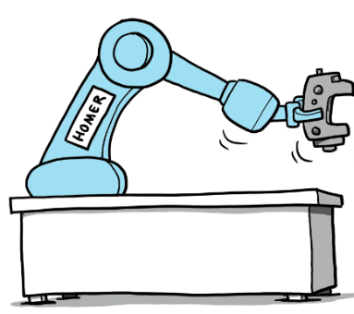
  Challenges of OSH management
New challenges:
(Hidden) bias in AI-based systems
Cybersecurity
Workers’ fears and expectations
Rapidly changing technologies mean little knowledge on OSH impact
Organisational and social impacts:
Depersonalisation
Less social interaction
Performance pressure
(Dis)trust in automation
Deskilling workforce
Notes:
Some companies hold ethical audits for their AI applications

Slide 23
OSH management
Reduce barriers
Enhance drivers
Inexperience with technology
Early worker involvement
Internal resistance to change
Exchange of expertise
Legal landscape
Human-in-command approach
European use cases

Slide 24



Using AI-based systems for OSH
Process and OSH monitoring
Feeling surveilled
Systems with built-in error detection
Safer workspaces
Self-learning systems
Uncertainty on what data is being collected
Increased presence of cameras
Underlying assumptions
Clear communication on what, when, where and to what end data is being collected.
Notes:
Data privacy in AI-based systems can be an issue of high complexity.
To safeguard the rights of workers, data protection officers should write codes of conduct to accompany any system processing sensitive data, as recommended in the European Union AI Act.
Companies should also communicate what type of data the system is processing, if it is recording any data and why any potential recordings are necessary.

Slide 25

Labour inspection
Labour inspection process more challenging
Policies for new technologies
New tools for labour inspectorates may be needed

Slide 26

Key takeaways
Careful selection of tasks to automate
Proper training and upskilling of workers
Information, communication, transparency
Worker involvement for a successful introduction of the technology
Regulation and enforcement considerations
Need for comprehensive risk assessment tools
Notes:
Other takeaways:
Challenges and risks can differ greatly from application to application
Cybersecurity should be considered since could have an impact on OSH
OSH management changes

Slide 27


Further information
Check out all related content under priority area “Automation of tasks”:
https://healthy-workplaces.osha.europa.eu/en/about-topic/priority-area/worker-management-through-ai
Consult all publications on the topic:
https://osha.europa.eu/en/publications-priority-area/automation-tasks

Slide 28
Neither the European Agency for Safety and Health at Work nor any person acting on behalf of the agency is responsible for the use that might be made of the following information.
© European Agency for Safety and Health at Work, 2024
Reproduction is authorised provided the source is acknowledged.
For any use or reproduction of photos or other material that is not under the copyright of the European Agency for Safety and Health at Work, permission must be sought directly from the copyright holders.

